Slide 1
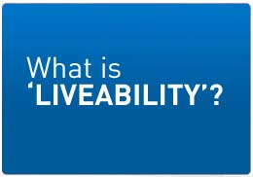
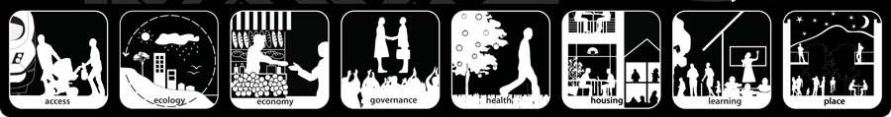
Lesson 2

Slide 2

'Liveability' - the qualities of a place (city, town, suburb, neighbourhood) that contribute to the quality of life experienced by residents and others.

Slide 3
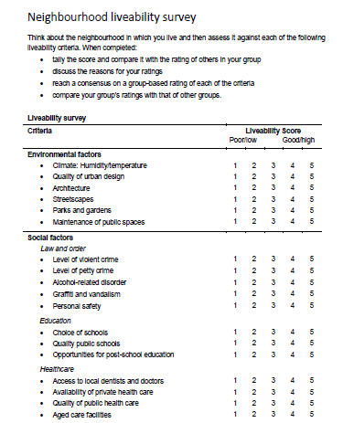
How ‘liveable’ is your suburb?
Complete the
survey

Slide 4
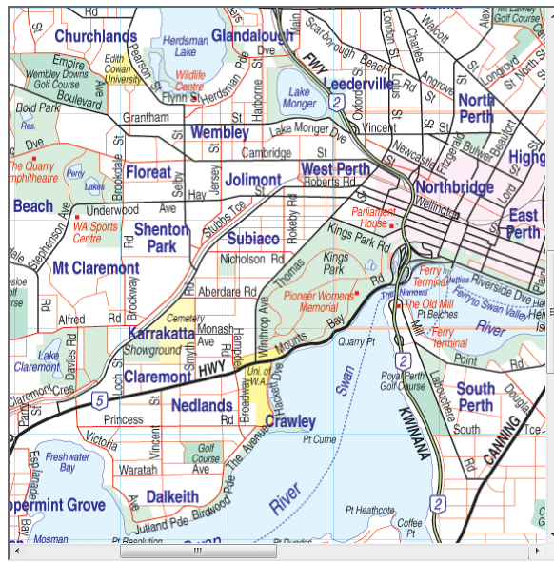
How ‘liveable’ is your suburb?
Use your own knowledge and the survey to create a flyer advertising the features of your suburb as a ‘liveable’ area.

Slide 5

In Mind

Slide 6
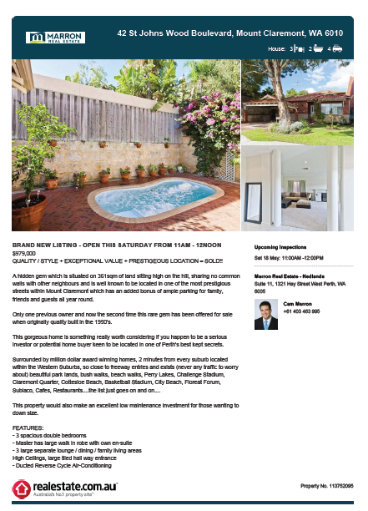

Slide 7


